Slide 1


Slide 2
Prometheus Basics
Overview
Architecure
Configuration & Installation
Prometheus UI & Matrics Capturing
PromQL
Validate Configuration
Configure External Web Application
Create/Update/Delete Matrics Scrapes

Slide 3
Overview
Open-source monitoring and alerting toolkit
Time series data identified by metric name and key/value pairs
PromQL, a flexible query language
multiple modes of graphing and dashboarding support
When does it fit?
Prometheus works well for recording any purely numeric time series
It fits both machine-centric monitoring as well as monitoring of highly dynamic service-oriented architectures.
When does it not fit?
If you need 100% accuracy, such as for per-request billing, Prometheus is not a good choice as the collected data will likely not be detailed and complete enough

Slide 4
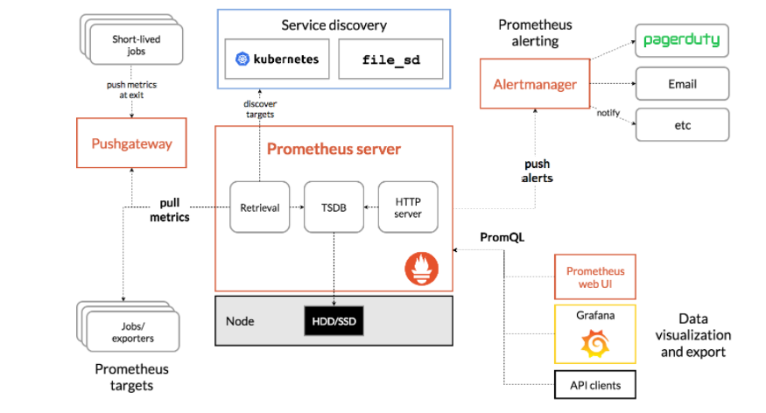
Architecture

Slide 5
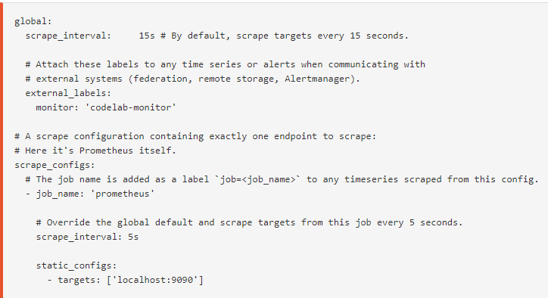
Installation & Configuration
Download the latest release of Prometheus for your platform, then extract and run it
Default configuration prometheus.yml

Slide 6
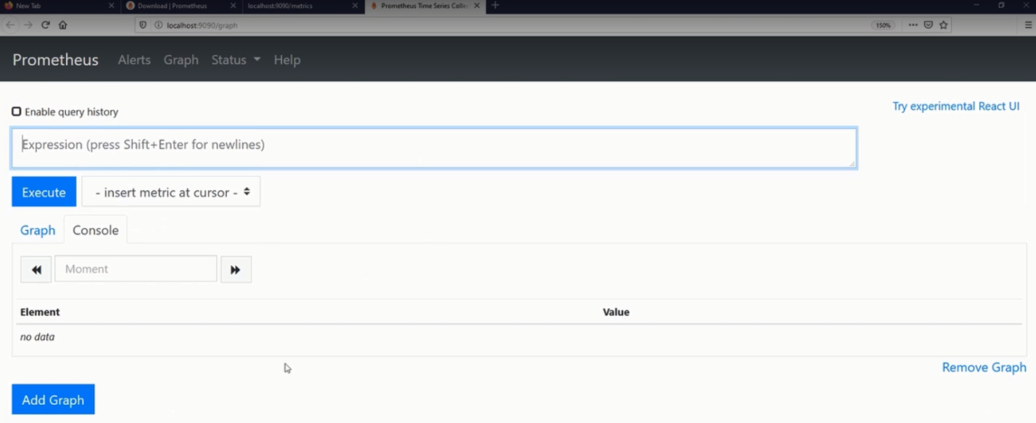
Accessing Prometheus UI
Prometheus UI at dafault port 9090

Slide 7
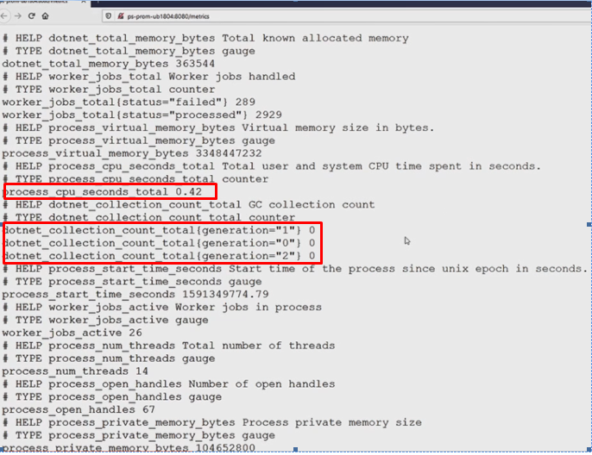
About Matrics
Matrics is data captured in key value pair

Slide 8
Types of metrics
COUNTER
A counter is a cumulative metric that represents a single monotonically increasing counter whose value can only increase or be reset to zero on restart. For example, you can use a counter to represent the number of requests served, tasks completed, or errors.
GAUGE
Gauges are typically used for measured values like temperatures or current memory usage, but also "counts" that can go up and down, like the number of concurrent requests.
Metrics Dictionary
This information is especially important when moving on to visualization or alerting
Exposition
After metrics are instrumented in an application, they have to be exposed so Prometheus can collect them. Typically this is done by exposing the metrics via a web server running on a particular port. Often the Prometheus client library being used to instrument will have a mechanism that makes exposition easy.

Slide 9
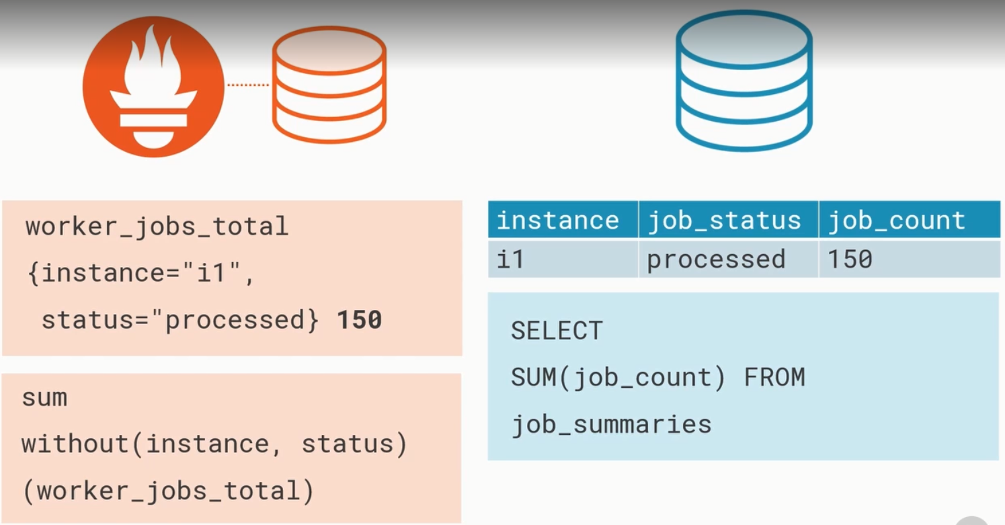
PromQL
Prometheus has its own query language called PromQL

Slide 10
Validate Configuration
Promethous has its inbuilt tool with installation to validate configuration file
To validate file need to run ptomTool utility with some option as below
promtool check config prometheus.yml

Slide 11
Exporters
An exporter essentially acts as a translator, retrieving data from the system and converting it to Prometheus-formatted metrics.
Below is a table of all of the exporters that are currently used in the Maul stack.
Exporter Platform Function
Blackbox Exporter All Collection of metrics from HTTP(S), DNS or TCP probes
Isilon Exporter IaaS Collection of Isilon metrics from cluster
Node Exporter IaaS Collection of Linux OS metrics
JMX Exporter IaaS Collection of Java metrics
PostgreSQL Exporter IaaS Collection of PostgreSQL server metrics
RabbitMQ Exporter IaaS Collection of Rabbit Message Queue metrics
Script Exporter IaaS Collection of metrics from return status and duration of scripts
SNMP Exporter Network Collection of SNMP metrics from network devices
Kube State Metrics CaaS Collection of Kubernetes object metrics
Kubelet CaaS Collection of Kubernetes container metrics
Micrometer / RSocket Proxy PCF Collection of Java metrics from Spring boot applications
vROPs Exporter IaaS Collection of metrics from vRealize Operations Manag

Slide 12
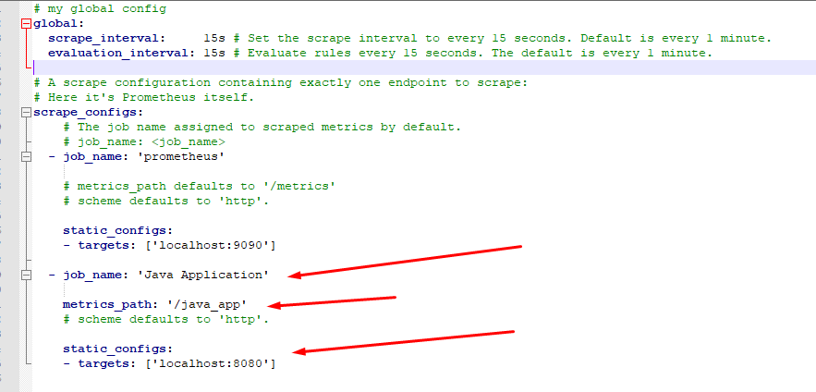
Configure External Web Application
Add Scrap configuration in prometheus.yml

Slide 13
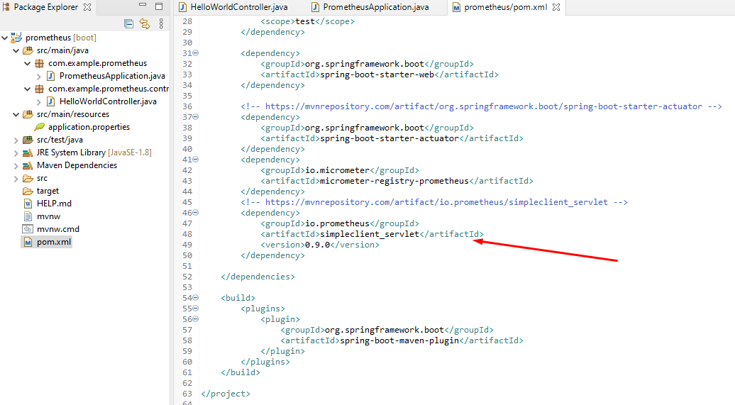

Slide 14
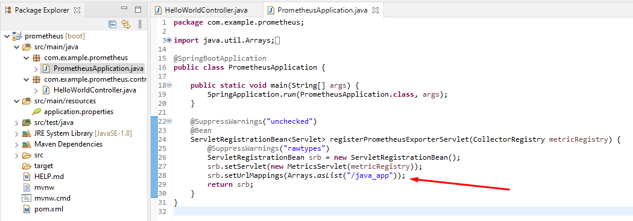
Configuration External Web Appllication

Slide 15
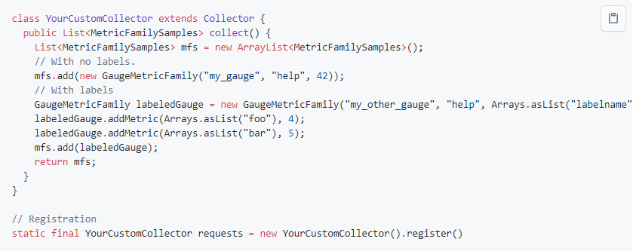
Create matrics
you need to create a custom collector (which will need to be registered as a normal metric), for example:

Slide 16
Thank you

